Slide 1
JMB Travels
FSD03 - Programming II
Group Project
Team: Mobin Syed, Bogdan Pristinsky, Johan elder

Slide 2

Connecting Businesses and Clients
A client has to find travel options from
amongst many providers.
A business spends money trying to drive
traffic to their site.
We can bring them all into one
location.

Slide 3
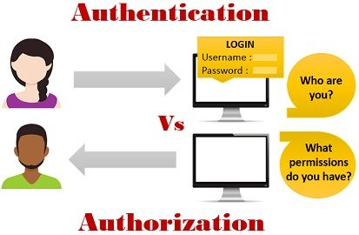
Authentication and Authorization:

Slide 4
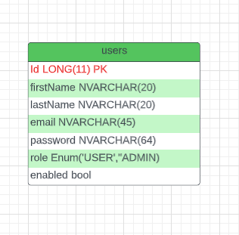
User Entity
User Entity:
Id, email, firstName, lastName,
Password,
RetypePassword(transient),
Enum Role{ USER(default), ADMIN)

Slide 5
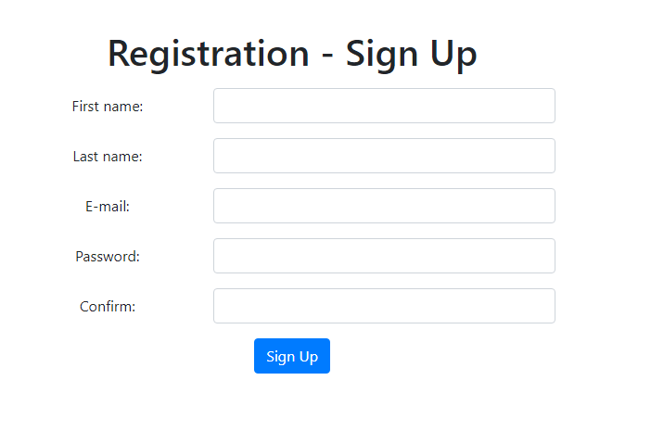
Registration form:

Slide 6
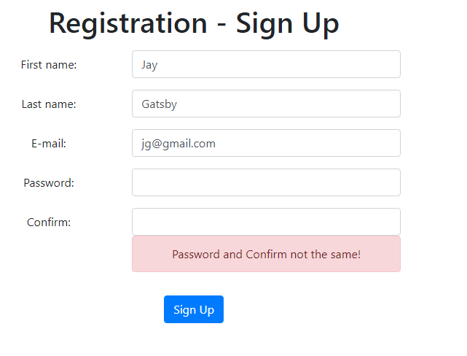
Validation of registration form
Validation prevent user from registration
With wrong credentials.

Slide 7
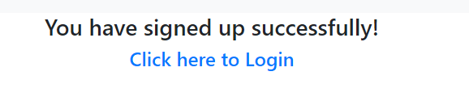
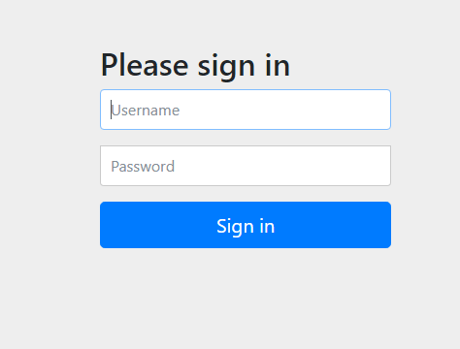
Successful registration and Authentication:

Slide 8


Authorization:
Default role for user is User:
Role ADMIN give permission to access
/admin/ part of app

Slide 9
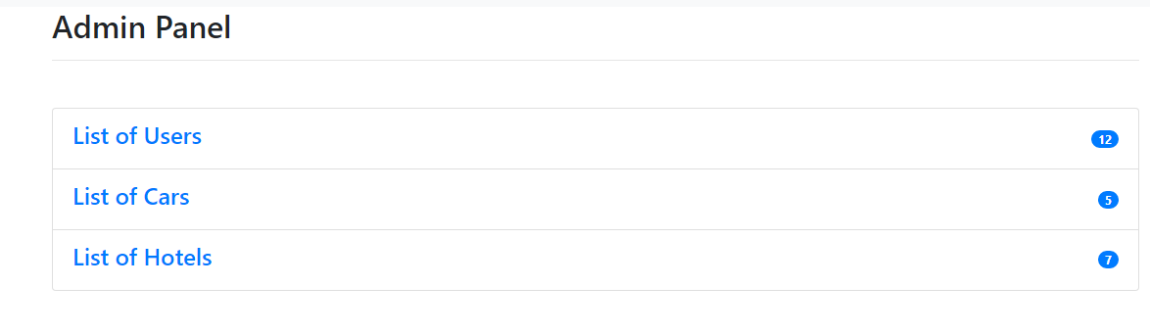
Admin panel
Admin users can
1 Modify Users
2 Modify Cars
3 Modify

Slide 10
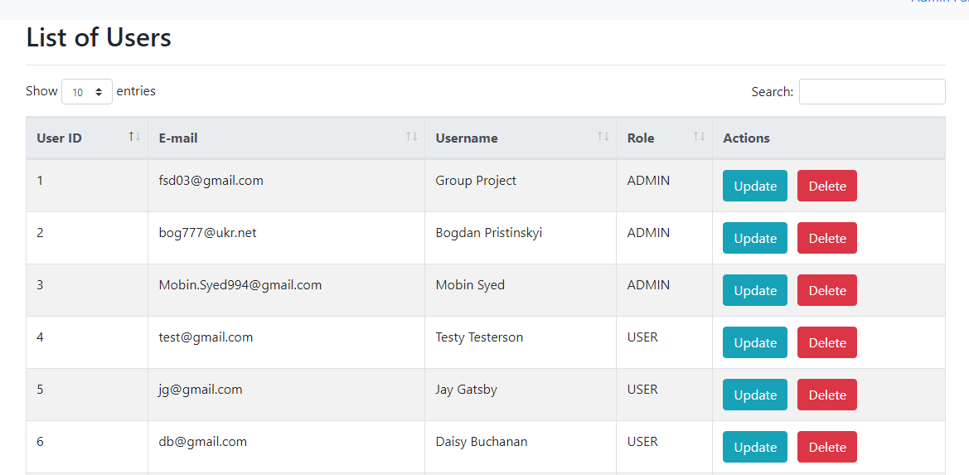
Admin panel - List of users
Admin user can
Update or Delete a user

Slide 11
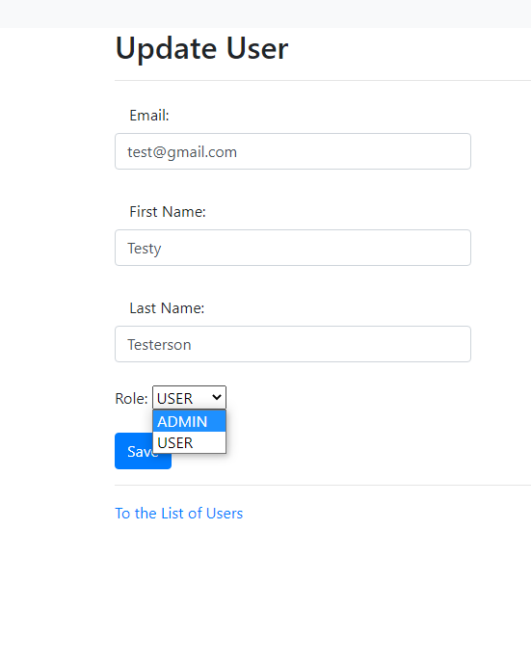
Admin Panel - Update user
Update User form:
Admin can modify Email, First Name
Last Name and Role Dropdown filed
With 2 options (ADMIN/USER)

Slide 12
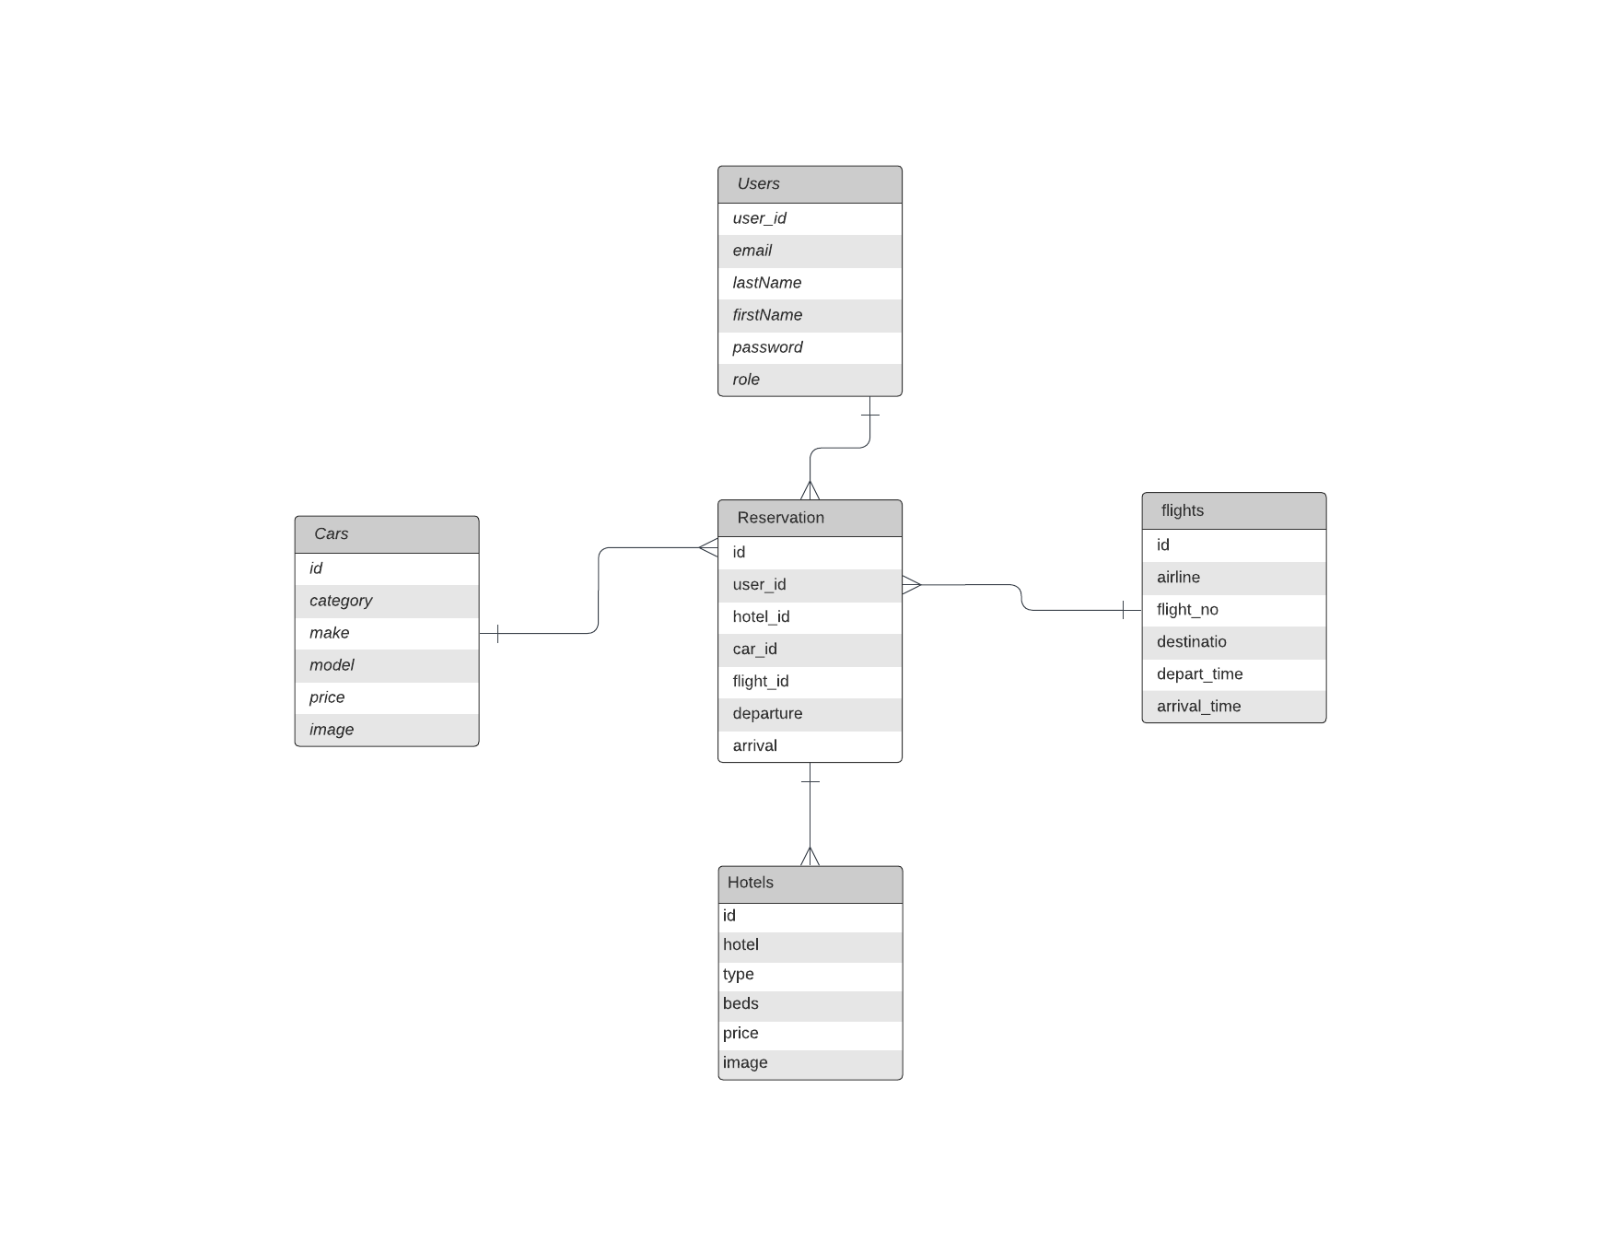
Database Design
Laying out the tables needed to serve our user stories

Slide 13
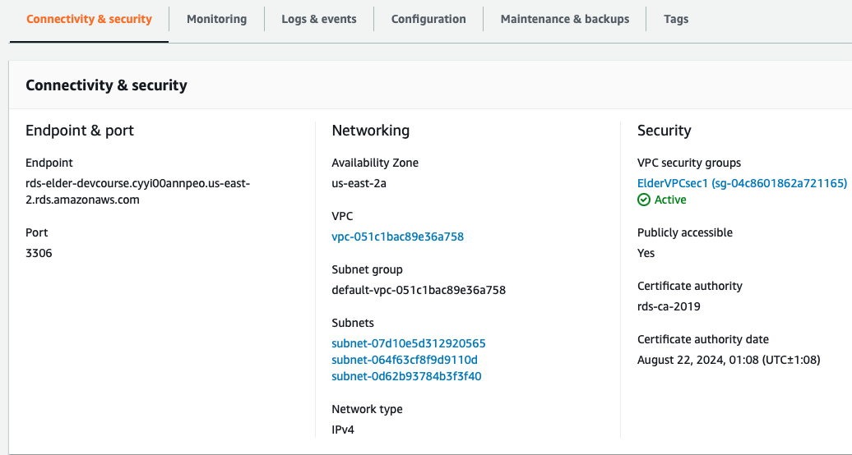
Technology: RDS
Used Amazon Web Services Relational Database System to host our schema.
Great option to have our database stored offsite in the cloud.

Slide 14
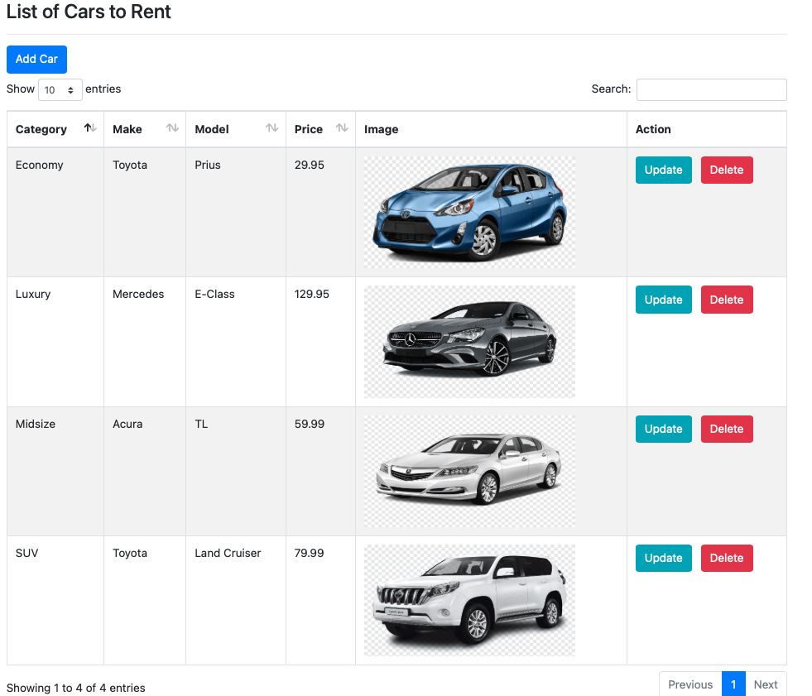
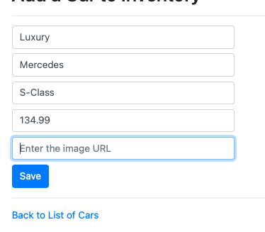
Admin vs User view
Admin view can add and modify to the table of cars available.

Slide 15
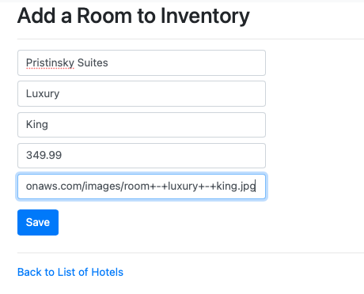
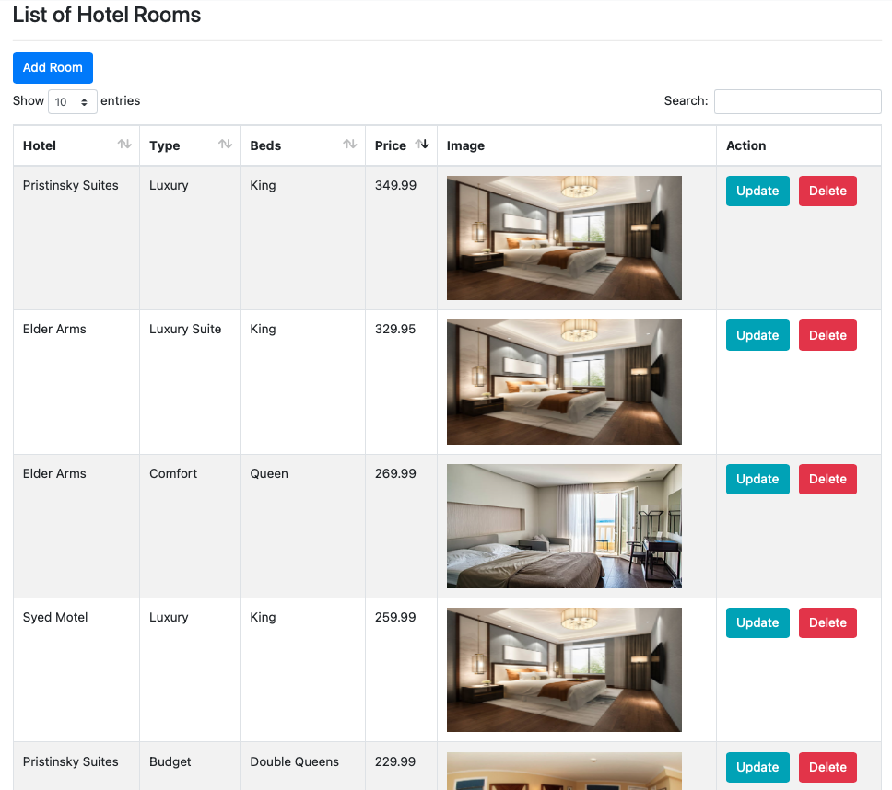
Same structure used for hotels:

Slide 16
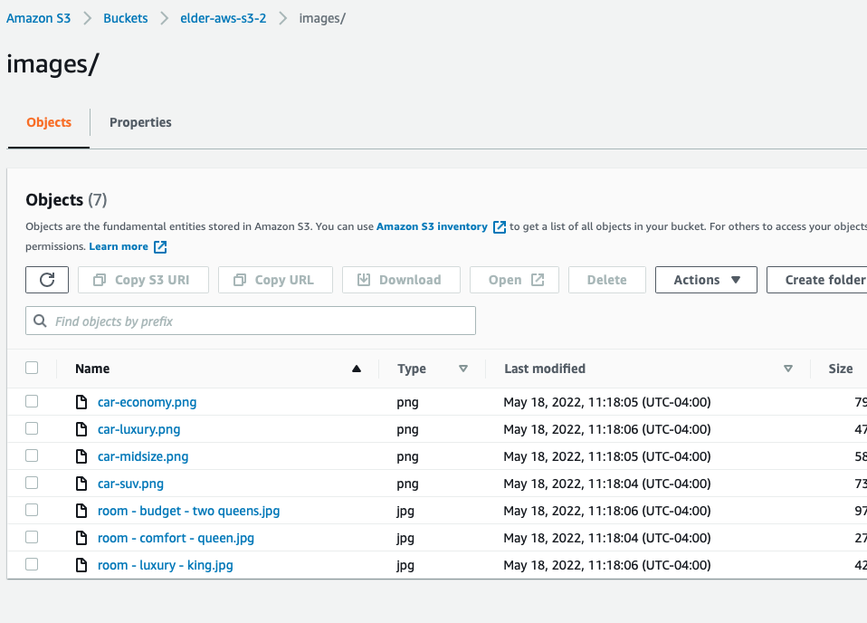
Technology: S3
Had issues working out uploading images into our database. Solution: use Amazon Web Services S3 storage option to create a bucket to store our files.

Slide 17
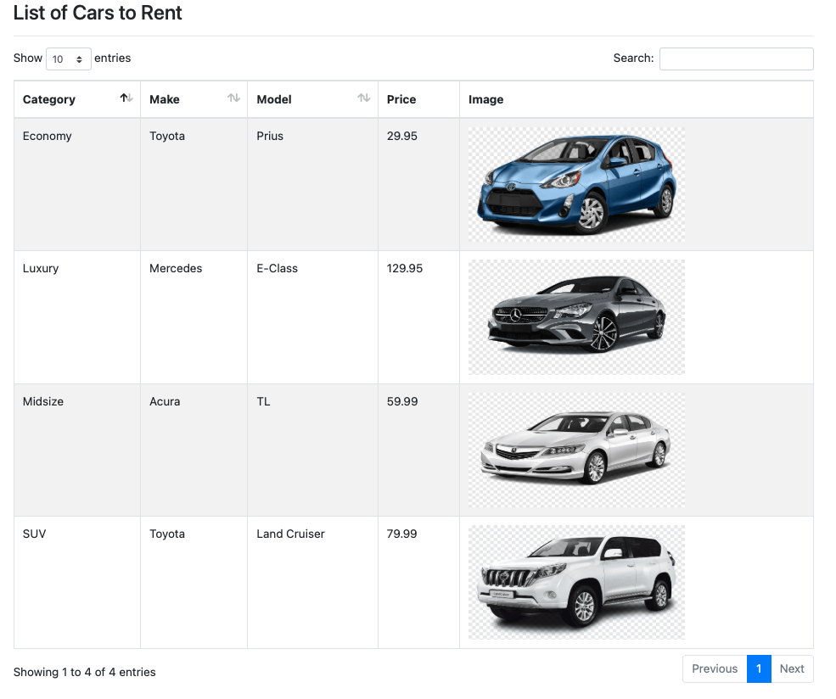
User View:
User has the same view of the cars in the database, only without controls.

Slide 18
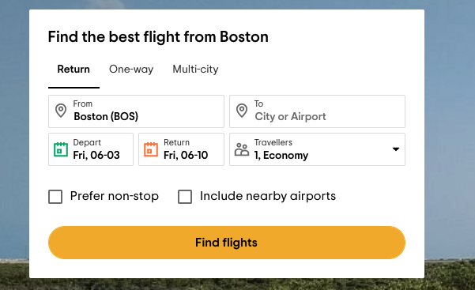
Flight search engine Goals/visions
Visions to make something
Similar to tripadvisor

Slide 19
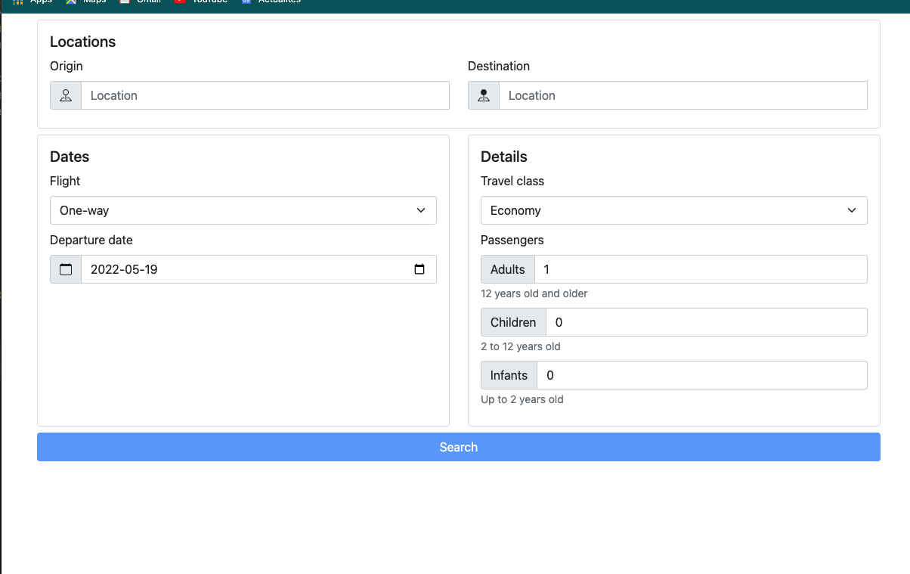
Flight search Using bootstrap
Used Amadeus API
bootstrap and java,
Dotnev module to load environments
Express for application framework

Slide 20
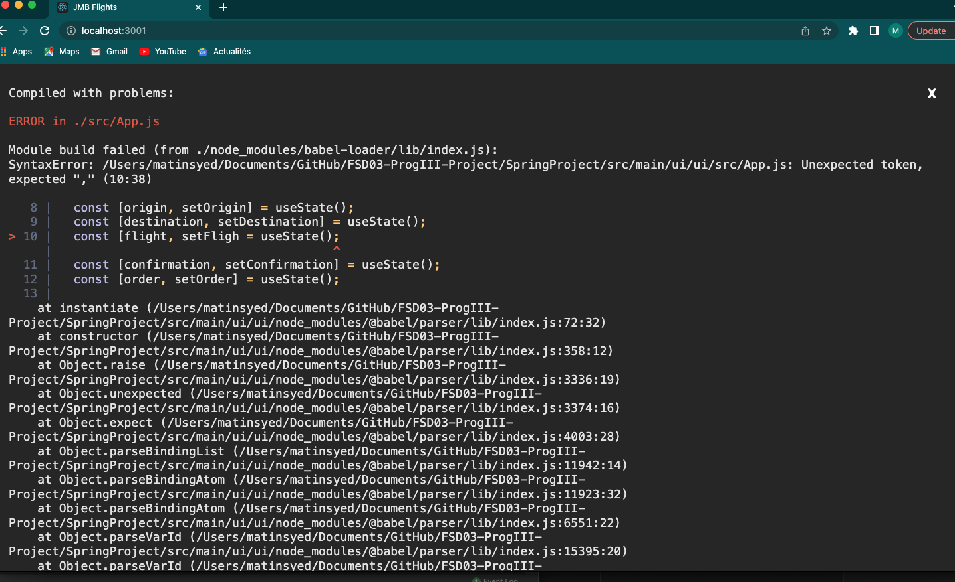
Flight search 2nd attempt
Tried using Java and React
Notes:
Use of npm

Slide 21
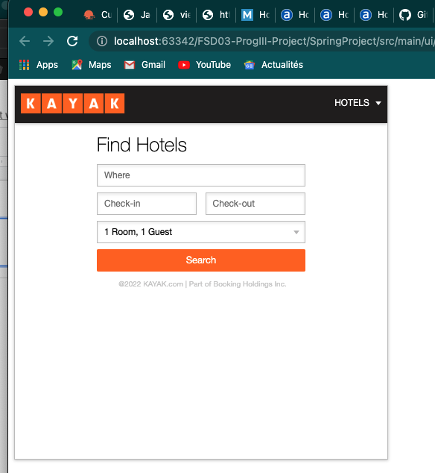
Flight search
Kayal API
Redirects you to their website(Not ideal)

Slide 22
Future goals
Get the search and booking engine to work properly and effectively
Try to monetize the project

